Slide 1
Capgemini -HSBC
CG Credit Score System
Eric
Jul, 2023

Slide 2
Requirement-Credit Score System
As-is
We found in the finacial market, the tranditional credit score FICO which was built by US is not suitable for small amount of loan as the e-payment is developing all over the world. However, thanks for China, they already advanced ahead on this area;our Capgemini China has the responsibility of introducing a new credit score system for our clients who can save money and time, focusing on their core business.
To-be
We will build a system to offer service of calculating out credit score by the data of customer of bank.
We will create a SAAS version for our client and deploy it on AWS cloud.
Our client could easliy sign up on the system and then directly invoke this service via RESTful API.
there are parts of this system
#1. Credit Score model
#2. Data Orchestration system
#3. Credit Score service wrap of the credit socre model
#4. Client management system including
user mangement, payment management, consuming management

Slide 3
Requirement-Data Orchestration System
build a batch file orchestration processing system, the required feature as below:
#1. create jobs and schedule auto trigger these jobs. We will have two sort of job,
file watcher job which will watcher a specific file by name in fixed directory folder
data process job which will invoke the data process flow via API or other way
such as, at 9:00am daily trigger the file watcher job and process job
#2. create tasks including data validation, load data into temp DB table, store data in DB permanent table, merge DB table , invoke model
each task of the rule of processing, configurated in json file , so that we can change the rule without modifying
the system code. eg. validation rule is field of column A , data type is number , length 10,
#3. create pipeline, comprise of tasks chose from the task #2
eg. load data pipeline has , validatation, load,store;
merge data pipeline with validation, load, merge;
#4. invoke model API to process
implementation way
#1. by python created by your own
#2. in Aws cloud to implement

Slide 4
Requirement-Credit Score Model
Use the German Credit Data to build a model of credit score
The model we will choose the Logistic Regression which is commonly used in finacial industry
Delpoy this model as the RESTful API, so that the data orchestration system could send data and invoke the model to run out credit score report for particular customer;

Slide 5
Requirement-Credit Score Service
Deploy the credit score as a service, so that other application or system could invoke this service and return the score report for the upstream team.

Slide 6
Requirement-Client Mangement
We provide SAAS version service for users to invoke, user could sign up and call for this service with the API token; they can freely use the service in 1000 times; if over it, they have to buy the service of 50,000 times
by 50 yuan per month.

Slide 7
Supplement-Configuration merge pipeline
{
“name” : ”merge data”,
“sourceSystem” : ”lending”,
“pipeline”: “merge”,
“productId”: 44,
“dataFormat”: “CSV”,
“delimiter” : “,”,
“jobFrequency” : “DAILY”,
“mergeColumns”: [{
“sourceColumn”:”age”,
“targetColumn”: “tage”,
“dataType”:”int”
},
...
],
“sourceTable”:”t_person”,
“targetTable”:”g_group”,
“specailRule”:null,
“timestamp”: ”2023-06-11T09:18:09Z”
}

Slide 8
Supplement-Configuration store pipeline
{
“name” : ”load data”,
“sourceSystem” : ”lending”,
“pipeline”: “store”,
“productId”: 44,
“dataFormat”: “CSV”,
“delimiter” : “,”,
“jobFrequency” : “DAILY”,
“fieldlist”: [{
“name”:”age”,
“order”: 8,
“dataType”:”int”,
“length”: 10
},
....
],
“timestamp”: ”2023-06-11T09:18:09Z”
}

Slide 9
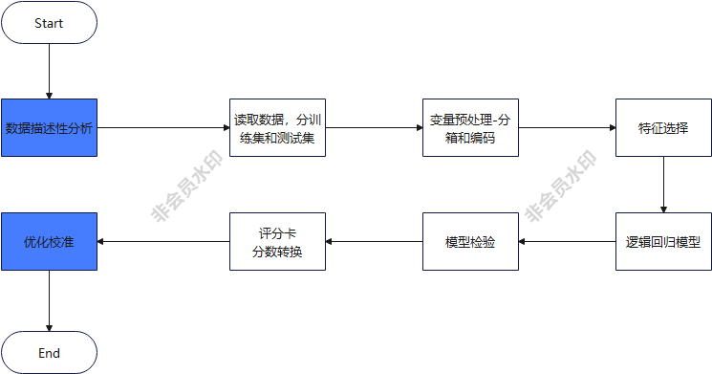
FlowChart- To Create a Credit Score Model

Slide 10
Reference- Tech stack
for the pipeline, task and auto schedule ; the recommended tech stack is Java SpringBatch, Java timer ,
for the service of API and client management , Java Spring boot as backend and Vue.js Ant component frontend
for the model, you can choose to implement it by native python data science lib, numpy, pandas and so on.
or you could swtich to AWS , tensorflow and pytorch for help.

